Slide 1

MINOR PROJECT- SECOND REVIEW ANALYSIS OF MARINE PLASTIC LITTER CONTRIBUTION BY VARIOUS COUNTRIES AND WASTE CLASSIFICATION
PROJECT GUIDE-DR.A.SHIRLY EDWARD
S SEETHALAKSHMI [RA1811004040001]
M RADHIKA [RA1811004040019]
ECE-A, IV YEAR

Slide 2
ABSTRACT
Marine debris – man-made objects that enter the marine environment through careless handling or disposal, intentional or unintentional release, or as a result of natural disasters and storms – is one of the ocean’s most pervasive, yet potentially solvable, pollution problems.
While there are different types of waste that are thrown along the shoreline due to the lack of awareness about proper disposal methods, the most concern causing among them all are the plastic wastes.
In our project we try to analyse the extent to which the countries around the world contribute to marine plastic litter and visualize the data.
Later in order to understand and classify the different types of wastes that are being disposed in an incorrect manner, we try to use classification techniques.

Slide 3
FLOWCHART
Data visualization
Waste classification
Importing Libraries
Loading image dataset
Training the algorithm
Importing Libraries
Loading Data
Plotting Data Distribution
Analysis & Visualization
Testing the algorithm
User Interface
Uploading the image of the waste to be classified.
Show the proper disposal method of the waste upon classification.

Slide 4
PROCESS A. AWARENESS THROUGH DATA VISUALIZATION

Slide 5
We downloaded a dataset that gave information about the extent to which a few countries around the world contributed to marine plastic litter.
The dataset takes into account different rivers of these countries as they act as conduits of litter from inland to ocean.
Analysing the datasets that inform the degree of plastic litter in various rivers from different countries would help in visualising the contribution of every country taken into account, importantly in visualising which country contributes the most.
We analyzed the data by plotting the distribution.
This process of data visualization gives a sense of understanding and awareness about the criticality of the issue.

Slide 6

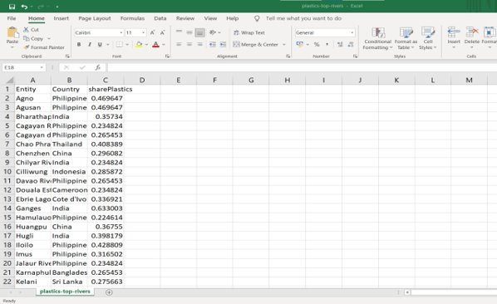



LANGUAGE USED:
Python 3
PLATFORM USED:
Jupyter Notebook
LIBRARIES:
numpy
seaborn
pandas
matplotlib.pyplot
DATASET:
plastics-top-rivers.csv

Slide 7
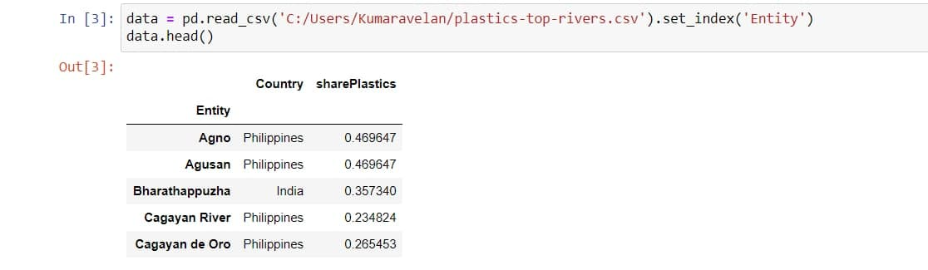
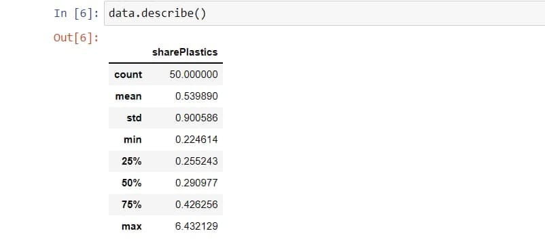
RESULTS

Slide 8
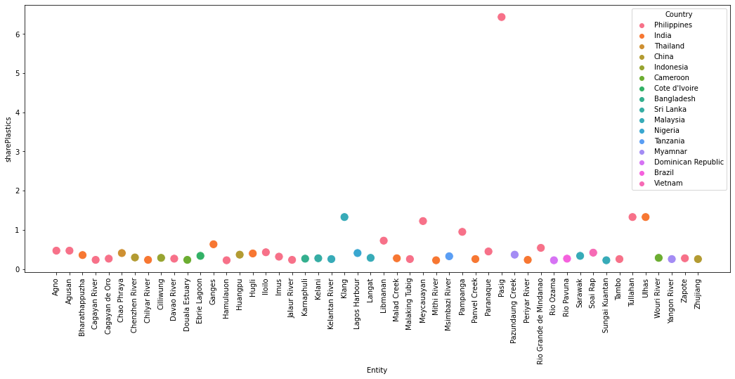

Slide 9
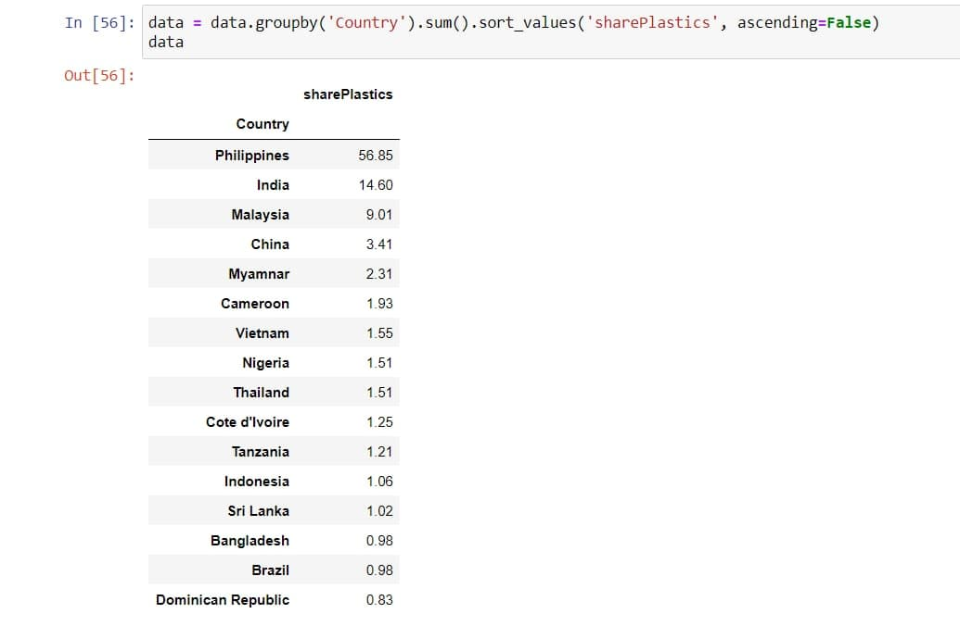
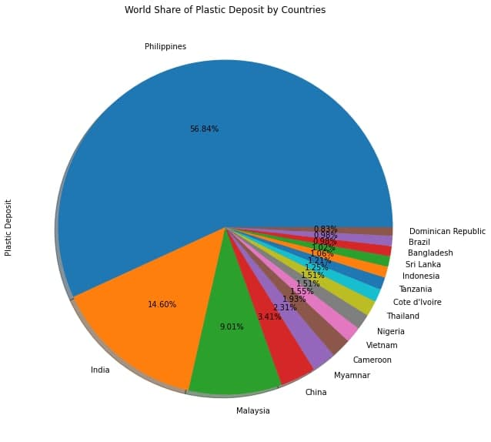
PASIG river of Philippines is high in plastic deposit, a world share of 23.83%.

Slide 10
B. A POTENTIAL SOLUTION THROUGH DATA(WASTE) CLASSIFICATION

Slide 11
Apart from just understanding the presence of plastic litter, it is necessary to classify the different categories of waste disposed along the shorelines.
We downloaded an image dataset consisting of approximately 8000 images.
All the images belong to the following 9 categories: light blubs, paper, plastic, organic, glass, batteries, clothes, metal and e-waste.
The dataset is trained using VGG16 Transfer Learning technique of CNN for classification.
We tried training the algorithm using different optimizers like Adam, Adamax and Nadam to check which provides the better result.
On feeding a test image, the algorithm correctly classifies the category of the waste
Though this is just a small scale implementation, it could be made large scale and useful in the future by making the automated detection process real time.
It could be installed in any drone or bot that might be used to categorically collect and dispose wastes from the shorelines in the future.

Slide 12
VGG-16
Oxford Visual Geometry Group (or) VGG-16 is a convolution neural network (CNN) architecture which was used to win ILSVR (ImageNet) competition in 2014.
The ImageNet Large Scale Visual Recognition Challenge (ILSVRC) evaluates algorithms for object detection and image classification at large scale.
ImageNet is a large dataset of 14,197,122 annotated images belonging to 1000 classes intended for computer vision research.
VGG-16 being a pre-trained model can be loaded via the Applications interface provided by Keras. By the method of Transfer learning, this model developed for a task is reused as the starting point for a model in our project.

Slide 13
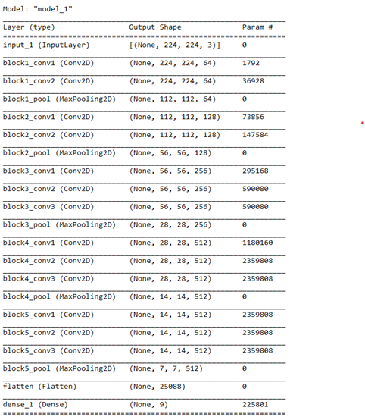
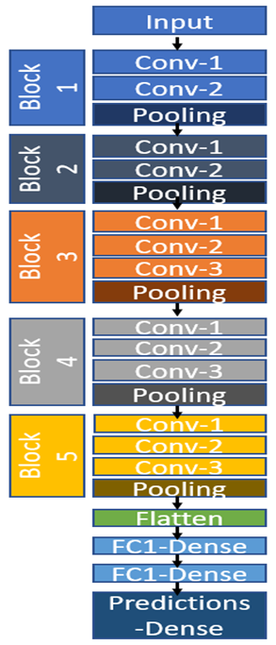
VGG-16 ARCHITECTURE
VGG-16 contains three different parts: convolution, pooling and fully connected layers — it starts with two convolution layers followed by pooling, then another two convolutions followed by pooling, after that repetition of three convolutions followed by pooling, and then finally three fully connected layers.

Slide 14
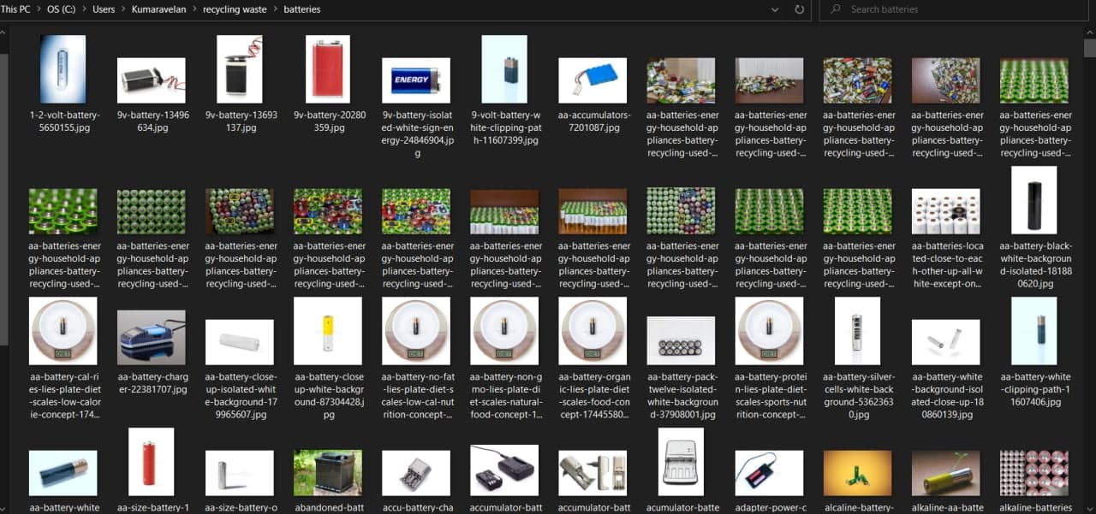
TECHNOLOGY USED:
Deep Learning
PLATFORM USED:
Jupyter Notebook
LIBRARIES:
Tensorflow -> keras
DATASET:
"recycling waste" image folder

Slide 15
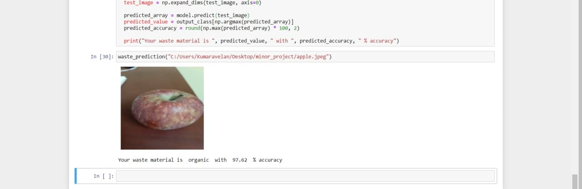
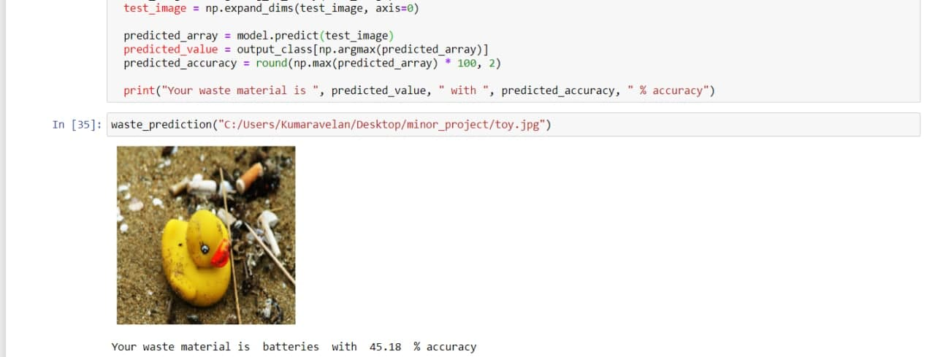
RESULTS
A. USING NADAM

Slide 16
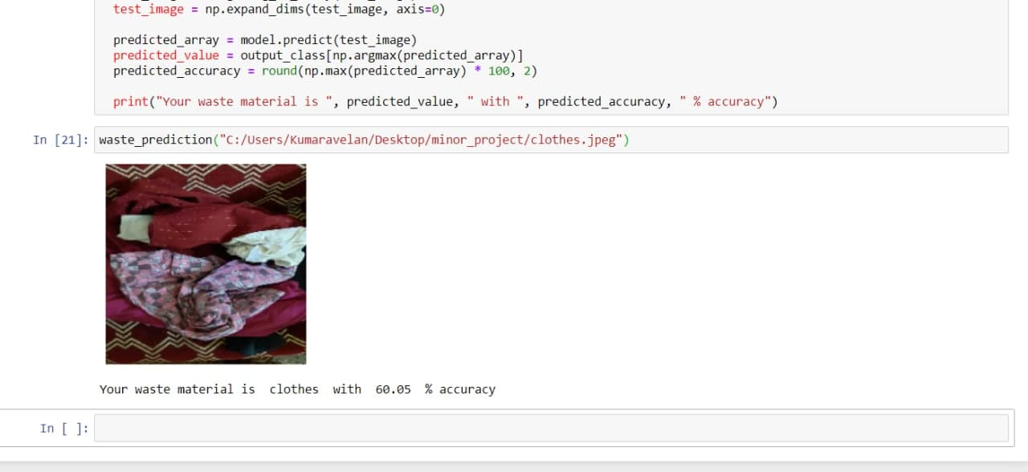
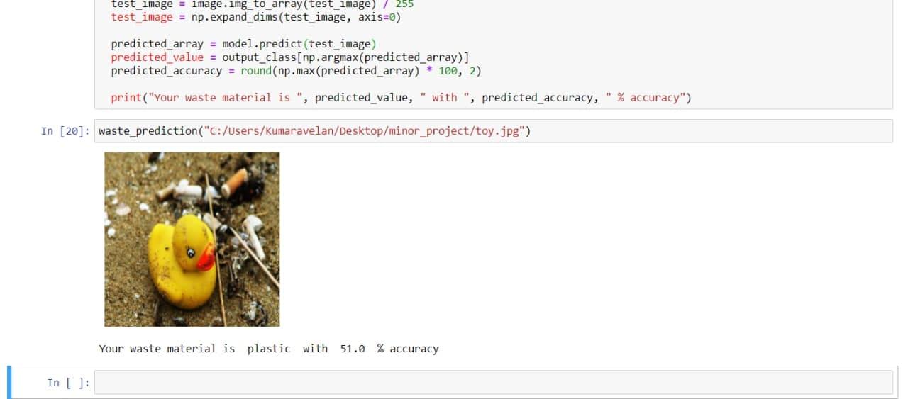
B. USING ADAMAX

Slide 17
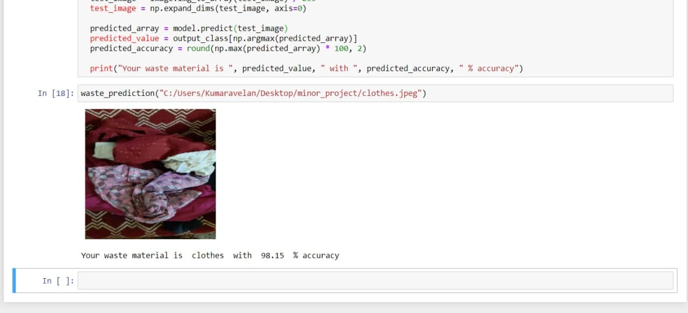
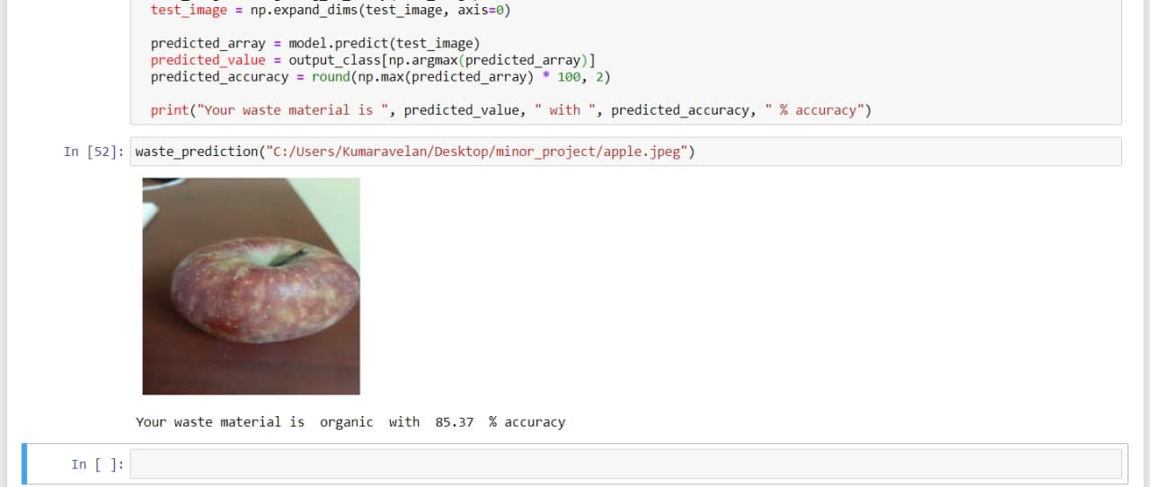
C. USING ADAM

Slide 18
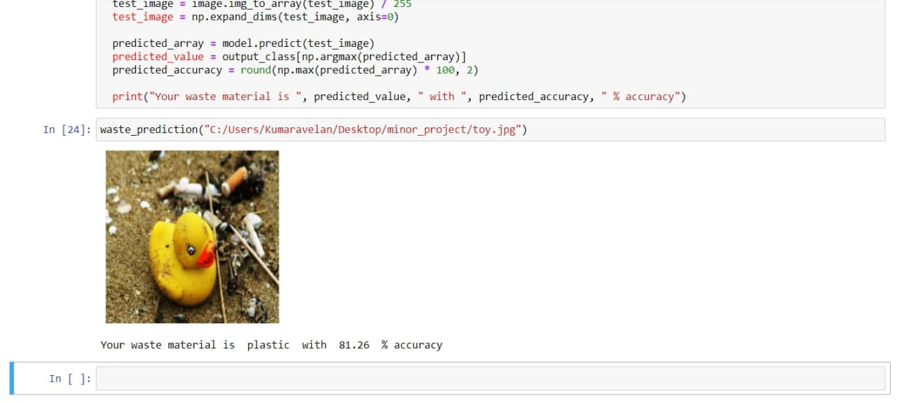
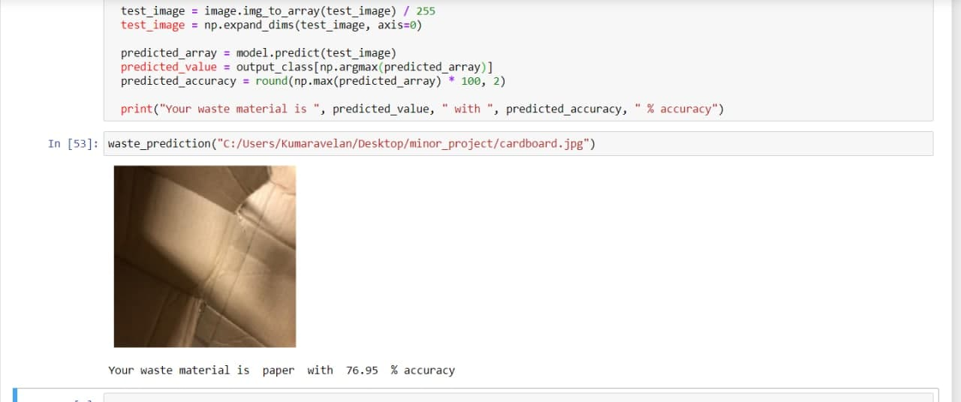

Slide 19
INFERENCE:
NADAM
ADAMAX
ADAM
On using three different optimizers, NADAM, ADAMAX and ADAM, we inferred the following:
The NADAM optimizer, even though it classified a few images into the right category with high accuracy, it did not classify most images in the right category at all.
The ADAMAX optimizer, even though it classified most of the images into the right category, the accuracy was low.
The ADAM optimizer classified most of the images correctly; the accuracy was better than that while using NADAM and ADAMAX too. Overall, it performed better than the other two.

Slide 20
FURTHER....
We plan to extend our project by developing a web application that would help in waste classification.
On uploading an image of any waste, the application would classify the waste to its respective category.
It would also provide the users with an insight on the particular type of waste and its proper disposal/recycling method.
This would help in creating awareness.

Slide 21
REFERENCES
[1] "Garbage recognition and classification system based on convolutional neural network VGG16" by Wang Hao, Wuhan University of Technology at 2020 3rd International Conference on Advanced Electronic Materials, Computers and Software Engineering (AEMCSE)
[2] "Very Deep Convolutional Neural Network Based Image Classification Using Small Training Sample Size" by Shuying Liu, Weihong Deng, Beijing University of Posts and Telecommunications, Beijing, China at 2015 3rd IAPR Asian Conference on Pattern Recognition.
[3] https://www.iucn.org/
[4] https://github.com/
[5] https://towardsdatascience.com/a-demonstration-of-transfer-learning-of-vgg-convolutional-neural-network-pre-trained-model-with-c9f5b8b1ab0a

Slide 22
THANK YOU

